Slide 1
Development of a new Python-based cardiac phantom for myocardial SPECT imaging

Slide 2
What is SPECT?
Single Photon Emission Computed Topography
Helps in cardiac imaging
Notes:
SPECT is a type of nuclear imaging test that shows how blood flows to tissues and organs
Myocardial Perfusion SPECT specifically used to evaluate blood flow to the heart muscle
Helps in diagnosing various heart conditions, such as coronary artery disease, and assessing heart muscle damage after a heart attack
Simulated Gated myocardial Perfusion SPECT simulates the heart’s pumping action (gating) to provide detailed images of the heart’s blood flow during different phases of the heart beat

Slide 3
Anthropomorphic Human Phantoms
Objects that simulate human tissues and organs to test and calibrate imaging devices
Used in nuclear medicine
Image acquisition
Reconstruction
Data analysis
Calibration, etc

Slide 4
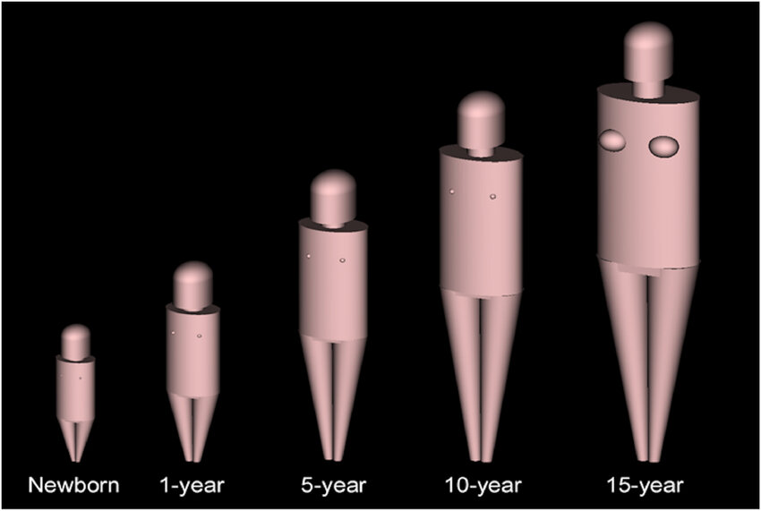
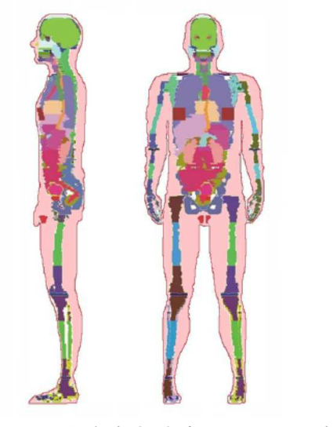
Types of Phantoms
Numerical Phantoms
Stylized Phantoms: Use mathematical equations to represent human anatomy
Analytical geometries
Voxel Phantoms: Use 3D imaging techniques like MRI or CT scans
More realistic, derived from human patients
Non-numerical phantoms
Physical models

Slide 5
Quantitative Measurements
End Diastolic Volume(EDV)
Volume of blood in the left ventricle at the end of filling
End-Systolic Volume (ESV)
Volume of blood in the left ventricle after contraction
Ejection Fraction(EF)
Percentage of blood pumped out of the left ventricle during each heartbeat
Phase Analysis, Wall Thickening Motion, Perfusion Parameters
Various measures of heart function and blood flow
Defect Extent and Severity, Stress and Rest Scores, Total Perfusion Deficit(TPD)
Assessment of areas with poor blood flow and overall heart health
Notes:
There are numerous software programs that are used to derive quantitative information from gated myocardial perfusion SPECT. Some of these measurements include:

Slide 6
The Problem
Current Cardiac Phantoms limited in realism and flexibility
Stylized Phantoms lack detail of anatomical model
Voxel Phantoms are rigid and less flexible

Slide 7
Study Aim
Design a computational cardiac phantom
Simulate interfering Parameters
Accurate phantom for validating and improving the quantitative analysis software
Computational Phantom
Versatile
Enhanced Accuracy

Slide 8

Why use Python?
High-Level programming language
Easy Syntaxes
Flexibility
More advantages over other languages

Slide 9


Python Libraries Used
NumPy: handling large datasets
SciPy:

Slide 10
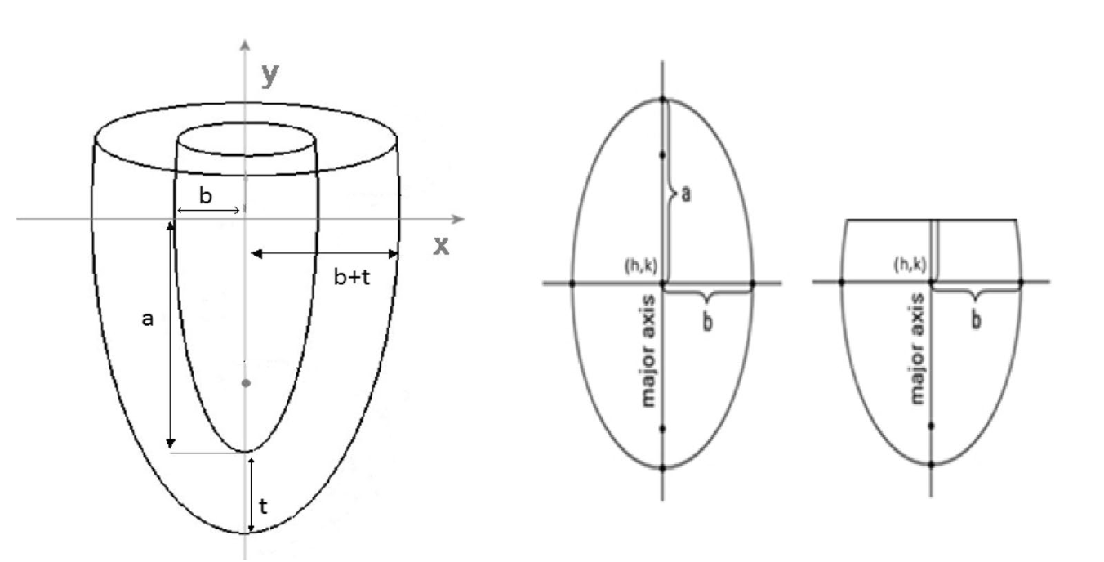
Results

Slide 11
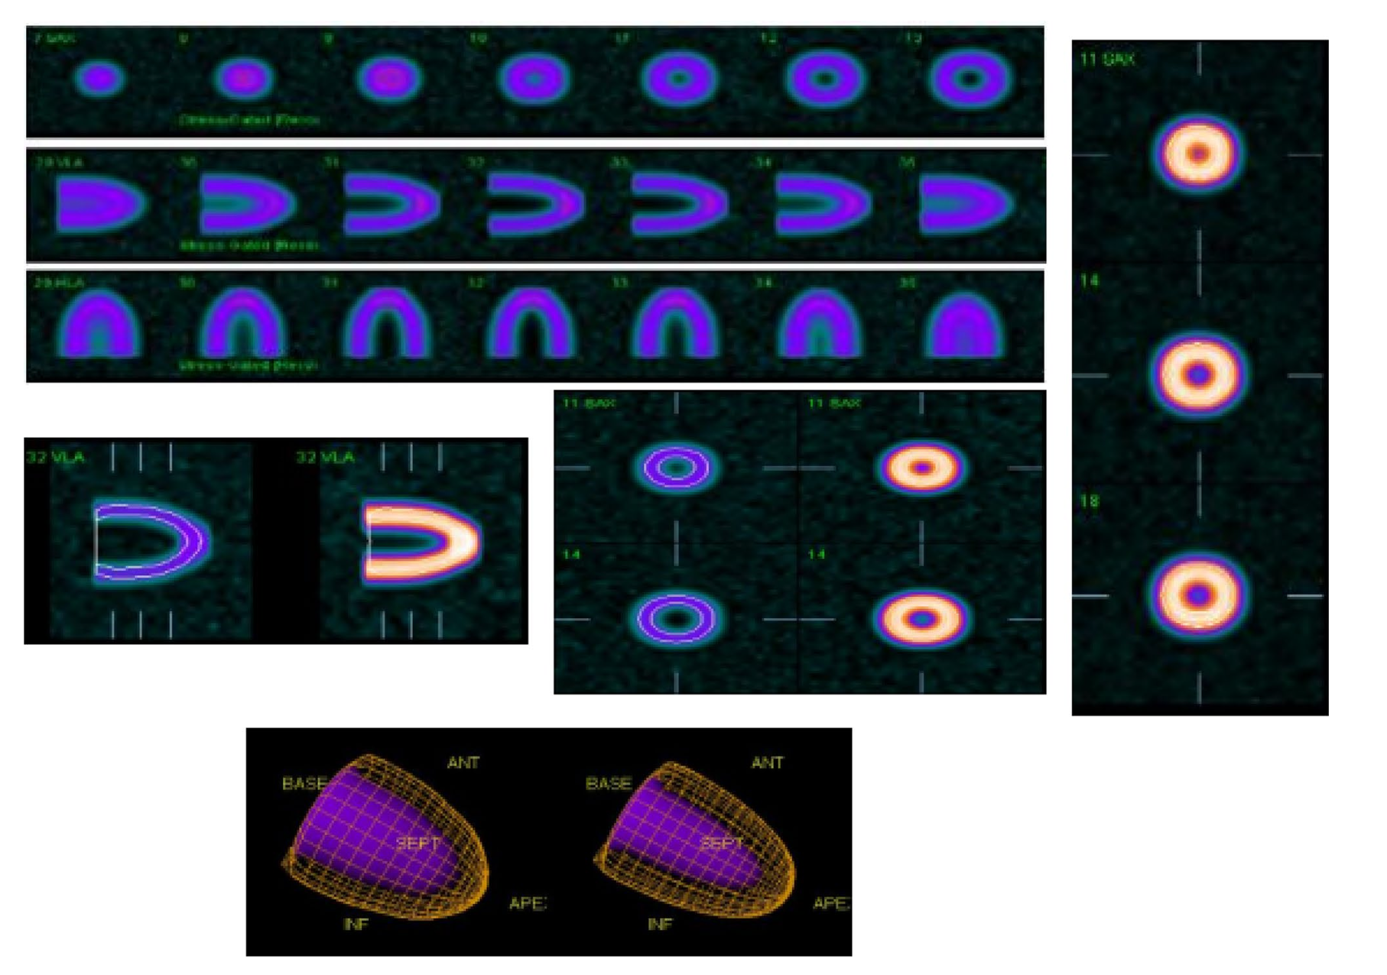
Results

Slide 12
My Thoughts

Slide 13
References

Slide 14
Questions

